Slide 1
NOVEMBER 2017
The secret value of existing customers
Alexandros Schizas – New Business Manager

Slide 2
We’re a
digital consulting and implementation agency
Designing and building unique, results driven, user experience centered applications.
Strategy
Creative
Technology
Marketing

Slide 3
MANAGEMENT
(2)
35
people
7 years
NEW BUSINESS
(2)
OPERATIONS
(2)
ACCOUNT
MANAGEMENT
(4)
PROJECT
MANAGEMENT
(4)
TECHNICAL
(10)
UX/UI
(6)
CONTENT
(3)
PERFORMANCE
(2)

Slide 4
We love working with them

Slide 5
Alex
Because if you don’t know what a client is worth, you don’t know what you should spend to get one or what you should spend to keep one.
The Coffee Lover

Slide 6
Because if you don’t know what a client is worth, you don’t know what you should spend to get one or what you should spend to keep one.
Alex
x
1,80 euro
7,20 euro / day
1,584 euro / year

Slide 7
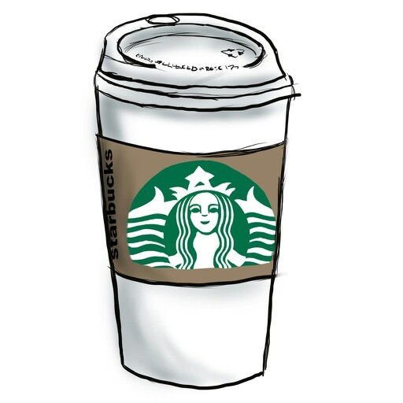
Life Time Value
LTV
=
$14,099
Average customer Lifespan = 2o YEARS
Because if you don’t know what a client is worth, you don’t know what you should spend to get one or what you should spend to keep one.

Slide 8
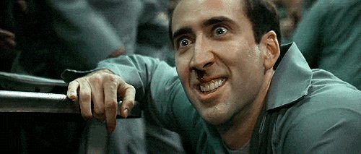
Bring Alex back !!

Slide 9
Retention
A business model indicator
Retention rate
=
No. Of customers
Time Range

Slide 10
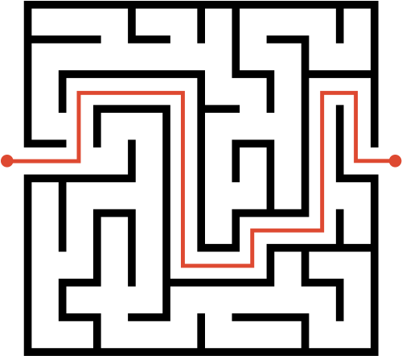
AWARENESS
New Customers
FAMILIARITY
Customer Acquisition is an expesive sport
CONSIDERATION
PURCHASE
?
Returning Customers
Competition is out there waiting for your customers

Slide 11
Revenue from returning and new customers
Total
New
Revenue
Returning
#New Customers
~
Marketing Budget

Slide 12
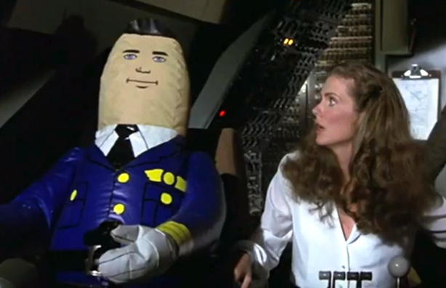
Autopilot…?Are you sure?

Slide 13
RFM MODEL
Your Personal blue ocean
Your Existing Customers are your secret competitive advantage
New Customers
Returning Customers
High Competition
Established Relationship
Limited Knowledge
In Depth Knowledge

Slide 14
RFM MODEL
Lets talk about cost
New Customers
Returning Customers
x7
Cost to acquire 1 new customer
Cost to retain 1 customer

Slide 15
Lets talk about profits
5%
Increase
Retention
75%
Profit Increase

Slide 16
Business as usual - Growth
LTV
CAC
+
=

Slide 17
All users are not equal, and you need to optimize for retention accordingly

Slide 18
Your Customers LTV hiding between your data
CMS
Web Analytics
Social Media
CRM
Ads

Slide 19
RFM model
Frequency: how often do they purchase? / how many orders they have placed in the given period
Frequency
Frequency
Monetary value
Recency
Monetary value: how much do they spend? / how many dollars they spent since their first purchase (Customer Lifetime Value)
Recency: how recently did the customer purchase? / the time when they last placed an order

Slide 20
Why RFM
List Segmentation: RFM helps us segment our contact list based on past purchase behavior
Goal Setting: Helps us set different goals based on contact behavior
Targeted approach: Gives us the opportunity to target each segment with a tailored approach

Slide 21
Strategy for Online Customer Segments
 | Customer Segment | Activity | Customer Score
Evangelists/ Promoters (HVC) | Champions | Bought recently, buy often and spend the most! | 12-15
 | Loyal Customers | Spend good money with us often. Responsive to promotions.
B. Active (MVC) | Potential Loyalist | Recent customers, but spent a good amount and bought more than once. | 7-11
 | New customers | Bought most recently, but not often.
 | Promising | Recent shoppers, but haven’t spent much.
C. Inactive (LVC) | Customers needing attention | Above average recency, frequency and monetary values. May not have bought very recently though. | 3-6
 | About to sleep | Below average recency, frequency and monetary values. Will lose them if not reactivated.
 | Can’t lose them | Made biggest purchases, and often. But haven’t returned for a long long time.
 | At risk | Spent big money and purchased often. But long time ago. Need to bring them back!
 | Lost | Lowest recency, frequency and monetary scores.

Slide 22
Tactics
RFM Segmentation
2nd Level Segmentation
(Behavior Data & Attidutional Data)
hvc
Newsletter Dynamic Workflows
Purchase
O
mvc
Custom Audiences Campaigns
lvc
Google Network
Facebook Network
LinkedIn Network

Slide 23
Marketing Automation
Tools & Tactics
Personas
Integrated Digital Advertising
Content Strategy
Contacts
Lead Scoring
Ads
Social Media
CTAs
Blog
Email
Workflows
Forms
Landing Pages
SEO
Analytics Reports

Slide 24
Loyalty Platform - HubSpot
CRM and Marketing Automation solutions can seamlessly be extended to a complete Loyalty scheme, either for B2B or B2C business models, tracking and analyzing demographics and behavioral data of visitors/customers, introducing gamification principles that enhance engagement and loyalty.

Slide 25
The Case
Competitive Advantage :
Customer Service
| After Sales
Strong Presentation with Physical Stores
Law Restrictions
Growth on online store
Goal :
Drive traffic to physical stores

Slide 26
Category A. High Value Contacts [HVC]
Reward Them
Buy More
Bring Them Back
Goal: Purchase – Coupon Used
Goal: Buy product of this category
Goal: Visit Our Eshop
O
O
O

Slide 27
High Value Contacts
Enrollment Criteria:
Contact is member of HVC I Never bought hlektroniko-tsigaro
Scenario: Contact has never bought product
of a certain category page:
hlektroniko-tsigaro
Send Email:
Limited offer for 1st purchase
If/ Then Branch:
Coupon Used
Recipients: ... contacts
NO
YES
Goal: Buy product of this category
Send email:
Reminder X days before expiration
END
If/ Then Branch:
Coupon Used
NO
YES
Update Custom Contact Property
HVC I hlektroniko-tsigaro
END
END

Slide 28
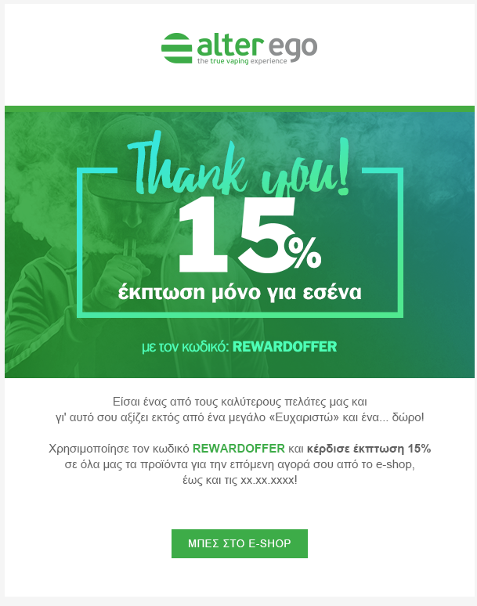
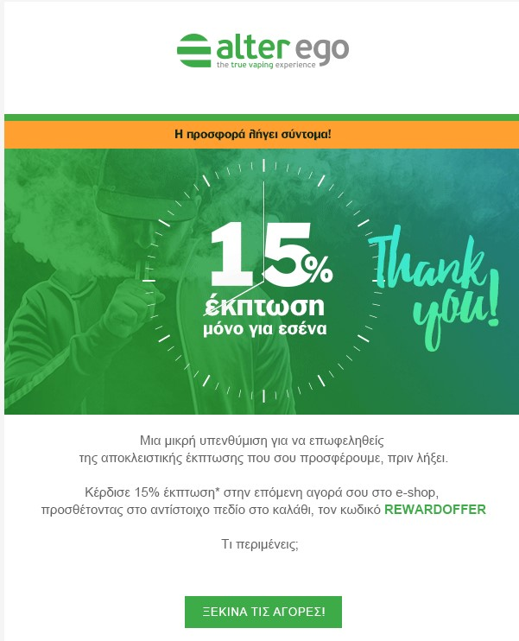

Slide 29
Category B. Medium Value Contacts [MVC]
Bring them back!
Buy More
Goal: Visit our site
Goal: Buy product of this category
O
O

Slide 30
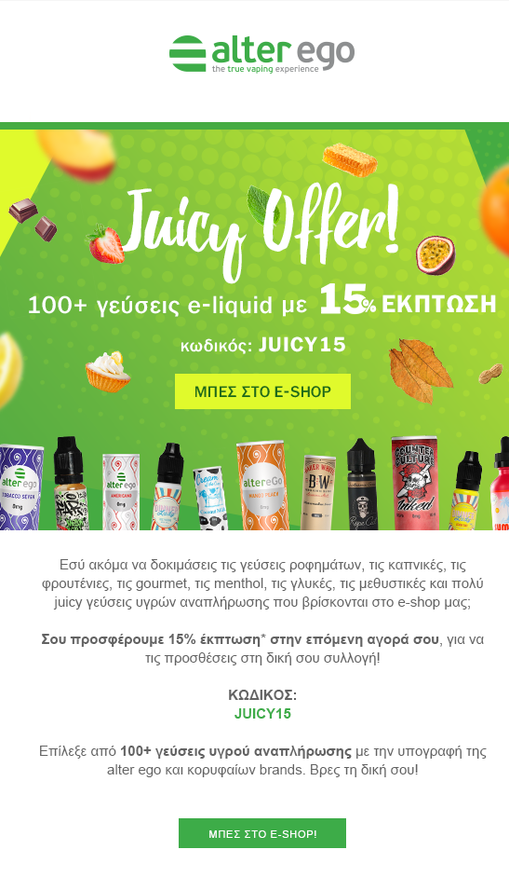
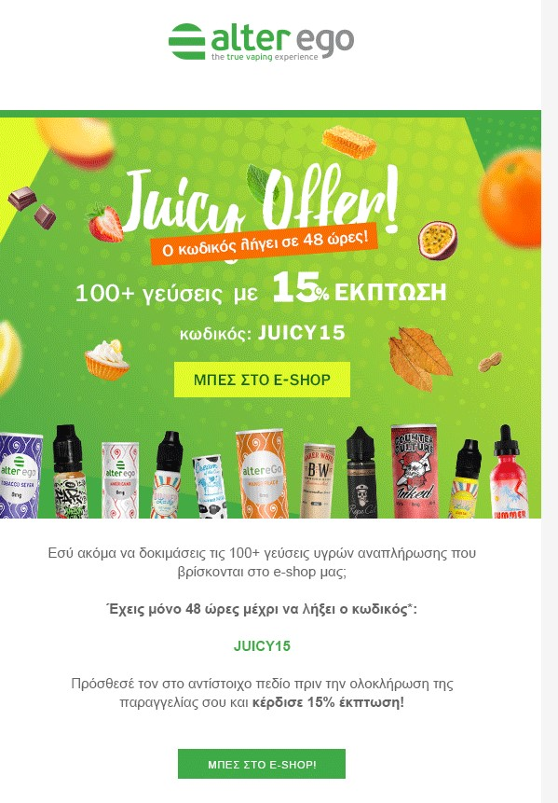

Slide 31
Category C. Low Value Contacts [LVC]
Bring them back!
Buy More
Goal: Visit our site
Goal: Buy product of this category
O
O

Slide 32
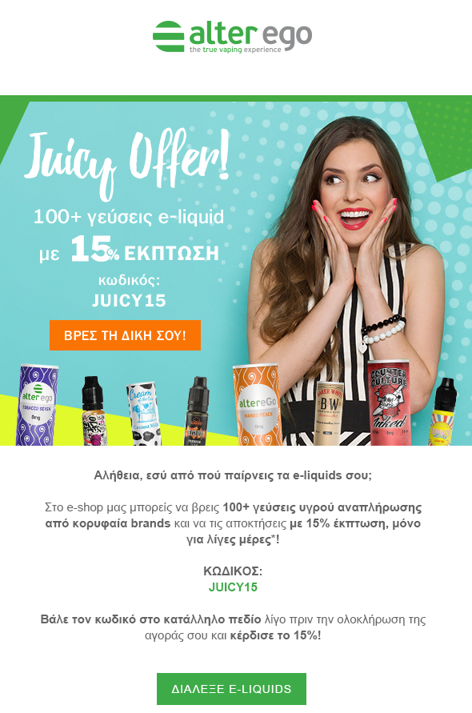
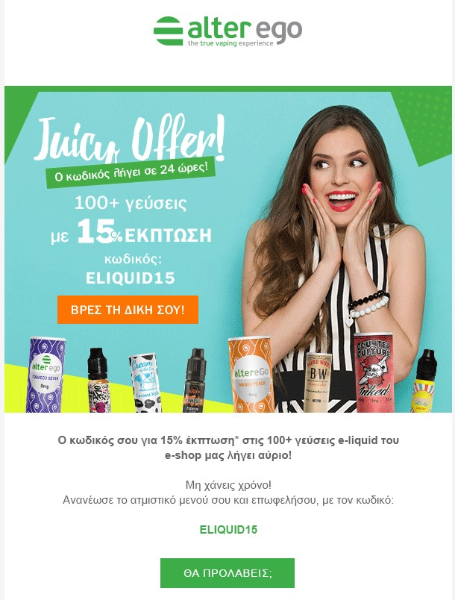

Slide 33
Results
12.02% Conversion Rate
36% Increase on HVC AOV
15% Increase on retention rate
14,7% CTR

Slide 34
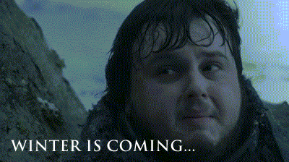
Black Friday
Christmas is coming

Slide 35
Thank you

